Slide 1


A Pairwise BERT Model for Contextual Emotion Detection
Nayemur Rahman Nayem Student ID: 19701039
Supervisor: Dr. Abu Nowshed Chy
Assistant Professor
Dept. of Computer Science and Engineering University of Chittagong
Chattogram-4331, Bangladesh
January 15, 2024

Slide 2
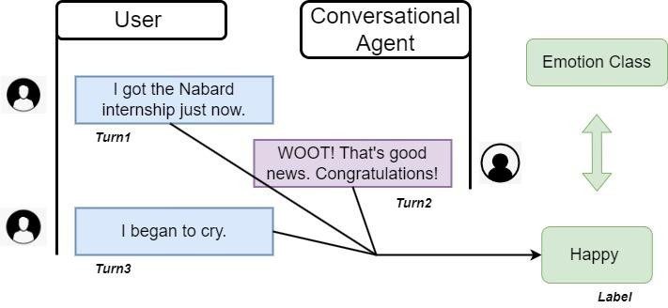

Problem Statement
Contextual emotion detection having two people in conversation
Turn2
Turn1
Turn3
Emotion of the Conversation

Slide 3
Motivation
Things that are motivating about this task.
Challenges in Emotion Recognition
The emotion of a dialogue keeps changing over utterances.
Dataset contains emoticons, short forms, and slang words
Technological Advancements and Opportunities
Chatbots like ChatGPT and Google Bard
Customer Review Analysis
Mental Health Assessment

Slide 4
Related Work
Chenyang et al. used a model that combines hierarchical LSTMs and BERT
– 2019
Sergey Smetanin introduced a deep learning model based on BiLSTM
- 2019
B. Senthil Kumar el al. proposed a Seq2Seq deep neural network to identify the emotions present in the text sequences - 2019
Lixing el al. introduced a Transformer based approach to detect the emotion
from a dialogue - 2021
Jaehyeok Lee, DongJin Jeong, and JinYeong Bak proposed a Cause Pair
Extraction (CPE) in Conversation With Contextual Information – 2023

Slide 5



Current Methodology
Dataset
Preprocessing
Pairwise
Interface
Output Matrices
Custom Tokenization
Micro avg. F1 Score
PyTorch Framework
Training Arguments Setting
BERT
Model
Training

Slide 6
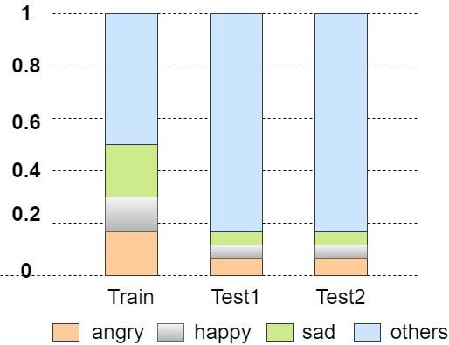
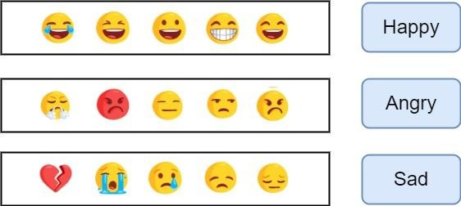
Dataset Description
Emotion | Train | Test1 | Test2
Happy | 4243 | 142 | 284
Sad | 5463 | 125 | 250
Angry | 5506 | 150 | 298
Others | 14948 | 2338 | 4677
Σ | 30160 | 2755 | 5509
Class distribution in the dataset

Slide 7
Data Preprocessing
Replacing Contractions
ASAP
As Soon As Possible
I'm
I am
Conversion of Emojis
😁
Happy
😠
Angry
😞
Sad

Slide 8
Custom Tokenization
Keeps Word Meaning
Deals with Unknown Words
Prepares Text for BERT
Improves Accuracy
CLS
Turn1
SEP
Turn2
SEP
Turn3
SEP
Input IDs
Attention Mask

Slide 9
Custom Tokenization ~ Example
Position | Token | Input Ids | Attention Mask
1 | [ CLS ] | 101 | 1
2 | I | 146 | 1
3 | love | 2347 | 1
4 | gaming | 16029 | 1
5 | [ SEP ] | 102 | 1
6 | 0 | 0 | 0
7 | 0 | 0 | 0

Slide 10
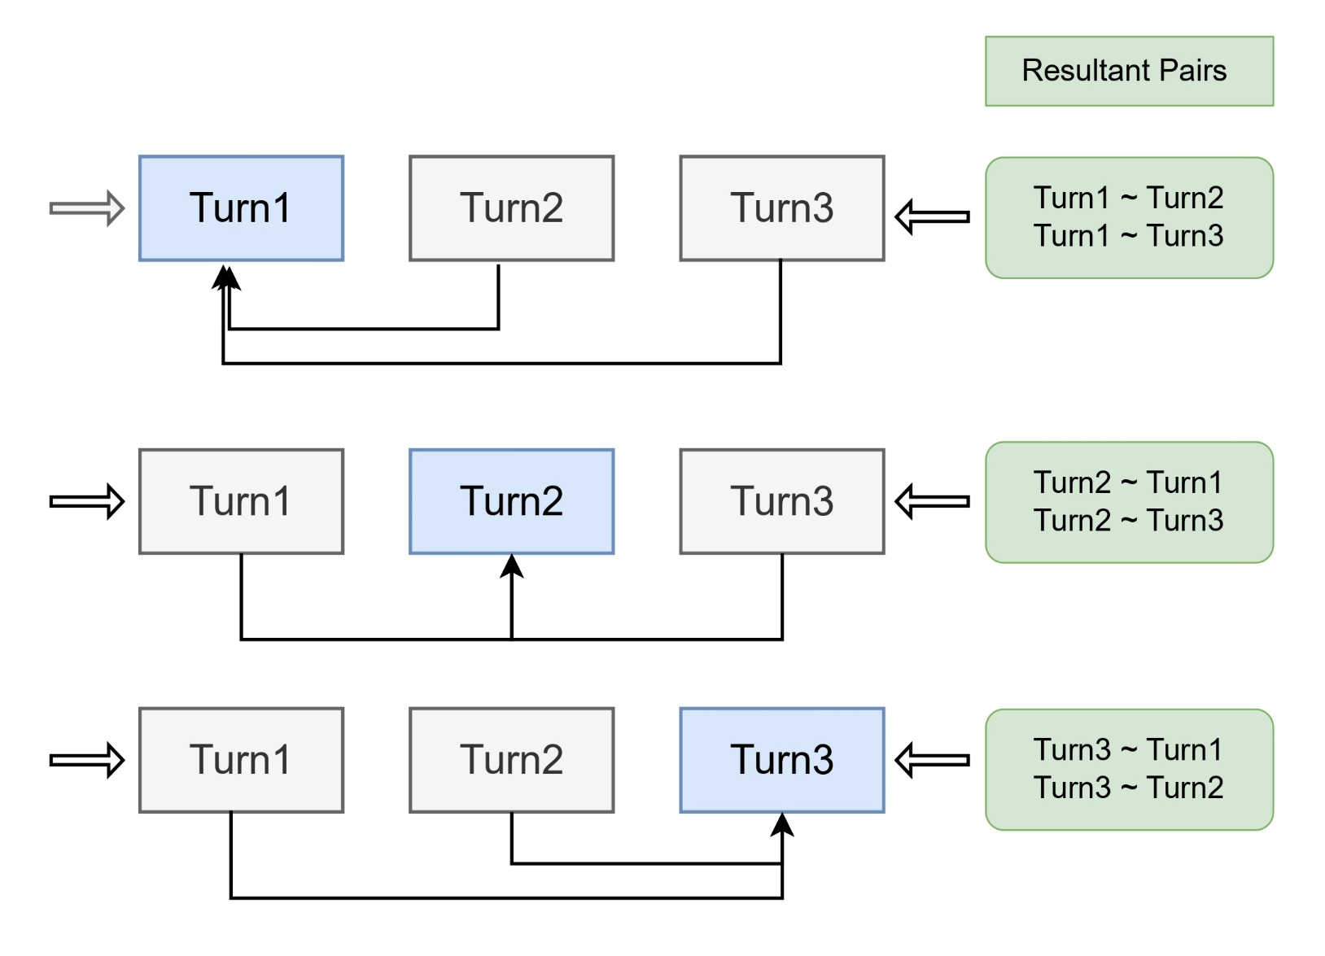
Pairwise Formation

Slide 11
Why PyTorch?
It is a framework that provides a flexible and efficient environment for building, training, and fine-tuning the BERT model
Easy to Customize
Fast with GPUs
Dynamic Computation Graphs
Autograd for Backpropagation
Support for Variable Inputs
Lots of Tools and Support
Strong Community and Libraries

Slide 12
Training Arguments Setting ~ Fine Tuning

Slide 13
Model Description

Slide 14
Preliminary Evaluation Results (Confusion Matrix)
Target Output | happy | angry | sad | others
happy | 217 | 1 | 0 | 66
angry | 2 | 265 | 3 | 28
sad | 0 | 13 | 214 | 23
others | 125 | 184 | 86 | 4282
Confusion Matrix for the Pairwise BERT Model

Slide 15
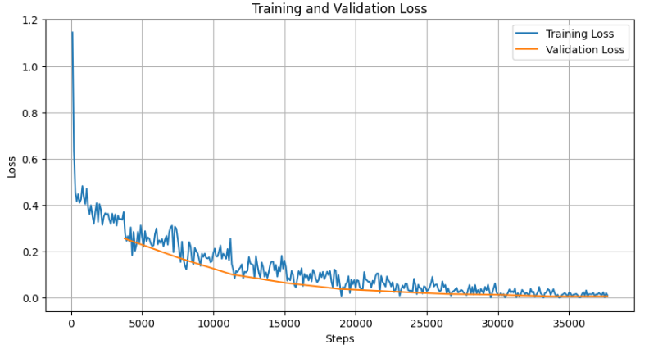
Preliminary Evaluation Results ~ Loss Curve

Slide 16
Conclusion

Slide 17
Future Work
sophisticated neural network architecture adept at capturing intricate patterns in sequential data by processing information both forwards and backwards
specialized architecture designed to learn the similarity between pairs of inputs by sharing weights between two identical subnetworks.
Bidirectional-LSTM based approach
Siamese Neural Networks based approach

Slide 19
Thank you

